Slide 1
Foodcritic
A chef code linting tool

Slide 2
Obtaining Foodcritic
foodcritic is part of the standard set of utilities included with the Chef Development Kit.
http://downloads.chef.io/

Slide 3
Using foodcritic
foocritic is a command-line application that evaluates your cookbook against a set of conventions and then reports the violations.
http://downloads.chef.io/

Slide 4
foodcritic Your Cookbook
$ rubocop cookbooks/iis
foodcritic will evaluate the cookbook found at the specified path.
https://docs.chef.io/foodcritic.html

Slide 5
Running foodcritic Within the Cookbook
$ cd cookbooks/redis
$ foodcritic .
foodcritic will evaluate the redis cookbook.

Slide 6

Community Conventions
It comes with 47 built-in rules that identify problems ranging from simple style inconsistencies to difficult to diagnose issues that will hurt in production.

Slide 7
Early and Often
The advantages of running foodcritic:
identify simple errors early
eliminating issues that violate conventions from the review process

Slide 8
Example results from foodcritic
FC003: Check whether you are running with chef server before using server-specific features: ./recipes/ip-logger.rb:1
FC008: Generated cookbook metadata needs updating: ./metadata.rb:2
FC008: Generated cookbook metadata needs updating: ./metadata.rb:3
https://docs.chef.io/rubocop.html

Slide 9
Violations found by foodcritic
FC003: Check whether you are running with chef server before using server-specific features: ./recipes/ip-logger.rb:1
FC008: Generated cookbook metadata needs updating: ./metadata.rb:2
FC008: Generated cookbook metadata needs updating: ./metadata.rb:3
https://docs.chef.io/rubocop.html

Slide 10
Reading results from foodcritic
FC003: Check whether you are running with chef server before using server-specific features: ./recipes/ip-logger.rb:1
FC008: Generated cookbook metadata needs updating: ./metadata.rb:2
FC008: Generated cookbook metadata needs updating: ./metadata.rb:3
FOODCRITIC (FC) VIOLATION:MESSAGE:FILEPATH: LINE NUMBER
https://docs.chef.io/foodcritic.html

Slide 11
Reading results from foodcritic
FC003: Check whether you are running with chef server before using server-specific features: ./recipes/ip-logger.rb:1
FC008: Generated cookbook metadata needs updating: ./metadata.rb:2
FC008: Generated cookbook metadata needs updating: ./metadata.rb:3
Rule Number: FC003 or Food Critic Violation 003
Message: Check whether you are running with chef server before us…
File path: ./recipes/ip-logger.rb
Line Number: 1
https://docs.chef.io/foodcritic.html

Slide 12
Violation Message
Check whether you are running with chef server before using server-specific features.
http://www.foodcritic.io/#FC003

Slide 13
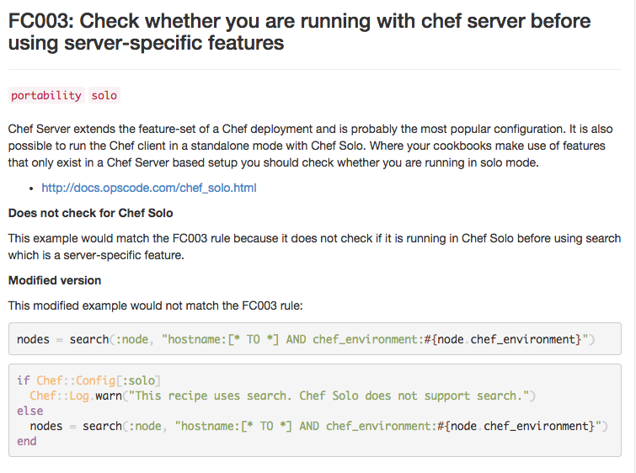
http://www.foodcritic.io/#FC003

Slide 14
Specific foodcritic rules only
$ foodcritic -t FC003 cookbooks/mysql
Run foodcritic to evaluate the mysql cookbook, in the cookbooks directory, if it violates Food Critic Rule 003 (FC003).
http://www.foodcritic.io/#FC003

Slide 15
Everything except that foodcritic rule
$ foodcritic -t ~FC003 cookbooks/mongodb
Run foodcritic to evaluate the mongodb cookbook, in the cookbooks directory, if it violates every rule except Food Critic Rule 003 (FC003).
http://www.foodcritic.io/#FC003

Slide 16
foodcritic rules are tagged
$ foodcritic -t services .
$ foodcritic -t ~style .
Run foodcritic to evaluate the current cookbook if it violates all rules tagged as services.
Run foodcritic to evaluate the current cookbook if it violates all the rules except the ones tagged as style.
http://www.foodcritic.io/#FC003

Slide 17
foodcritic rules combined
$ foodcritic -t services -t ~style -t ~FC002 .
Run foodcritic to evaluate the current cookbook if it violates all rules tagged as services but not if they are also style rules or food critic violation 002 (FC002).
http://www.foodcritic.io/#FC003

Slide 18
foodcritic rules combined
$ foodcritic -t services -t ~style -t ~FC002 .
$ echo "services,~style,~FC002" > .foodcritic
When I run foodcritic with no parameters I want the default rules to be:
all rules tagged as services but not if they are also style rules or food critic violation 002 (FC002).
http://www.foodcritic.io/#FC003

